Slide 1
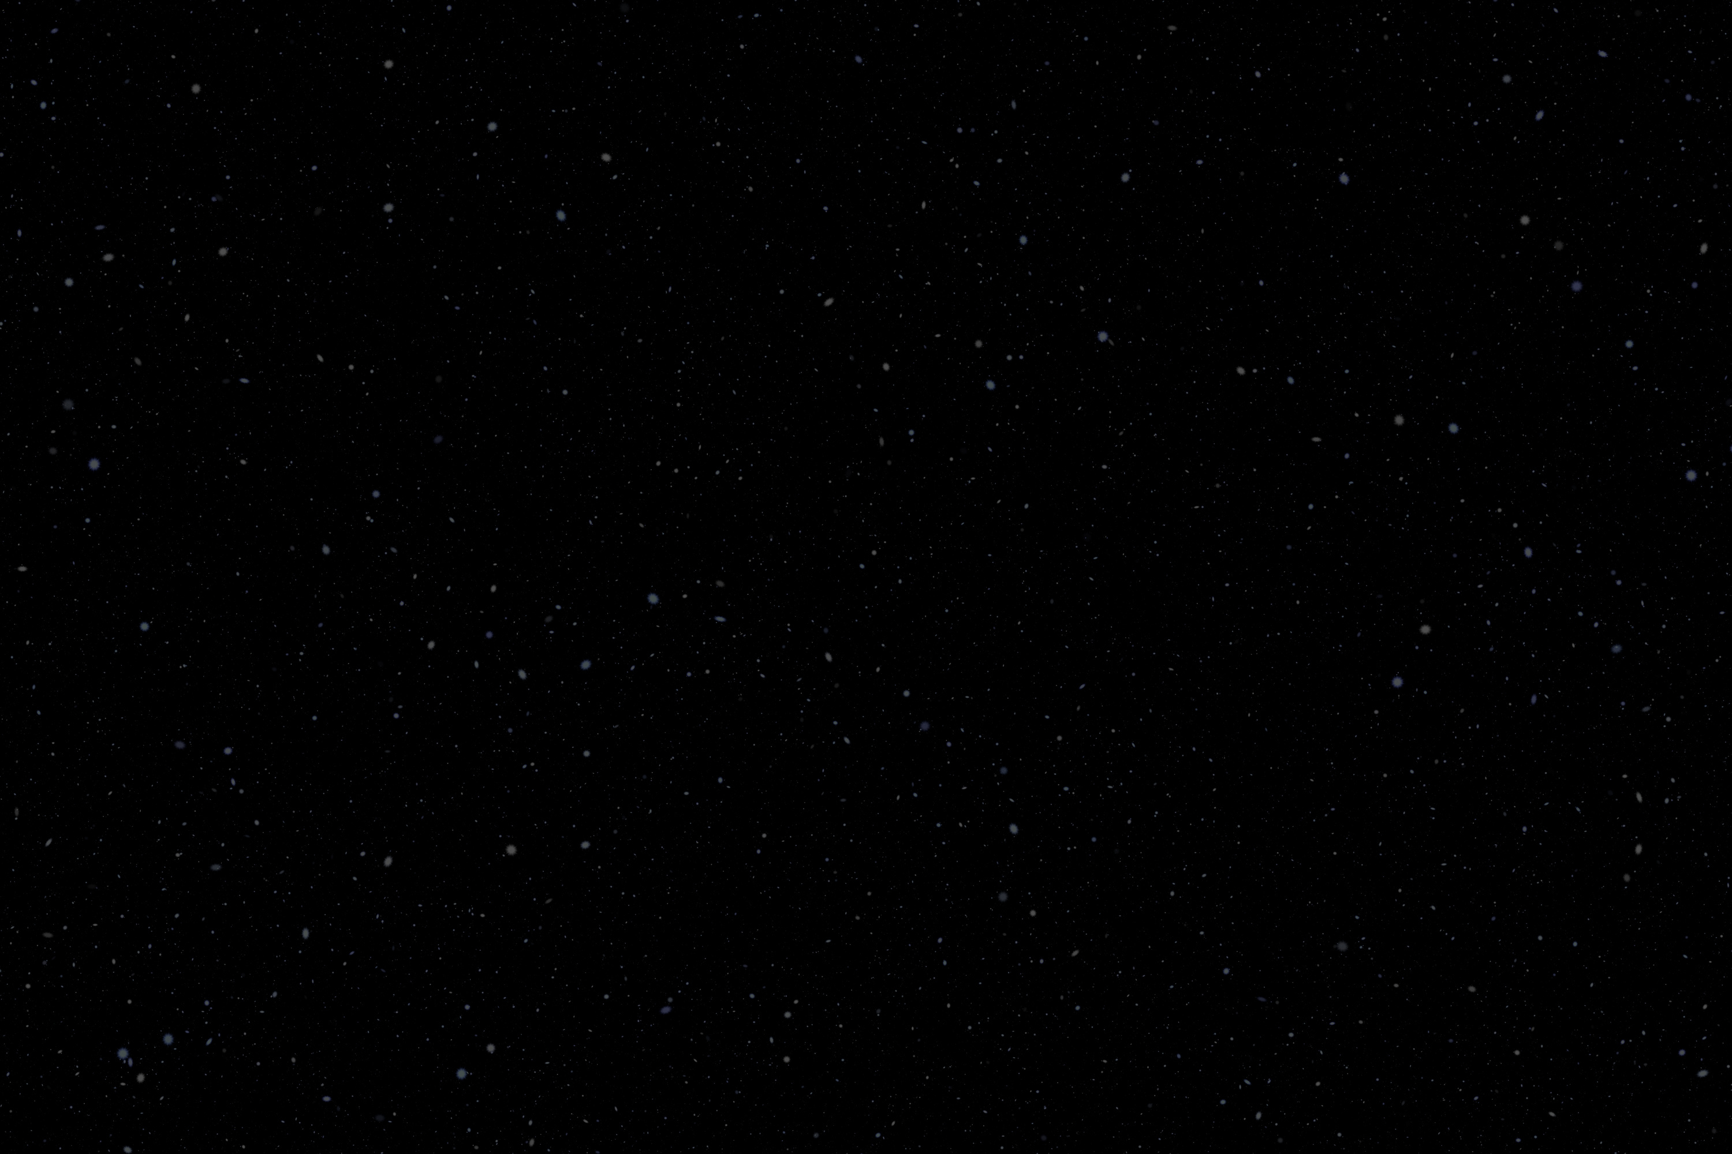
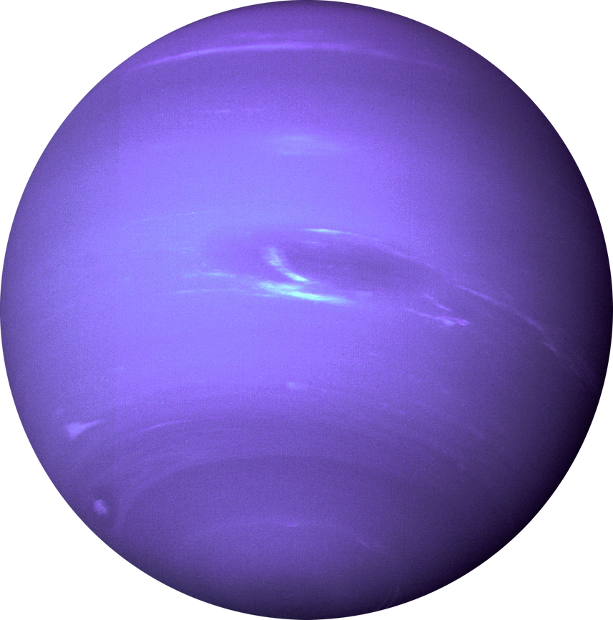

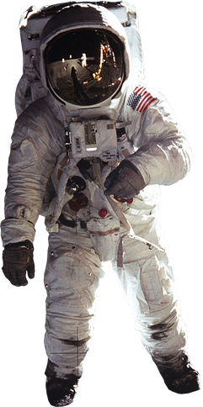
Methods & Techniques
POLICY GRADIENT PRO
DQN PRO
Adaptive Baseline Policy Gradient
Deep Q Network (DQN)
Modify the final reward by reward subtracting the baseline score
Lower variance & converges faster compared with Policy Gradient but less stable performance
Use Neural Networks to approximate Q(s,a) function when action space is large
Experience Replay Buffer to reduce temporal correlation in learning, with greedy epsilon search
Advantage Actor Critic (A2C)
Double DQN
Two networks, action value estimation and target network
DQN overestimates Q-function, DDQN fixes a target making it more stable, but slower at learning
Two networks, actor network and critic network.
Less random variables and lower variance, but need to balance variance and bias
Proximal Policy Optimization (PPO)
Duelling DQN
Clip the policy update in a trust region thus prevent large deviation
More stable, converge faster, higher score
Two networks, action selection and action evaluation
DQN overestimates Q-function, D2QN fixes by sampling Stable learning and performance

Slide 2
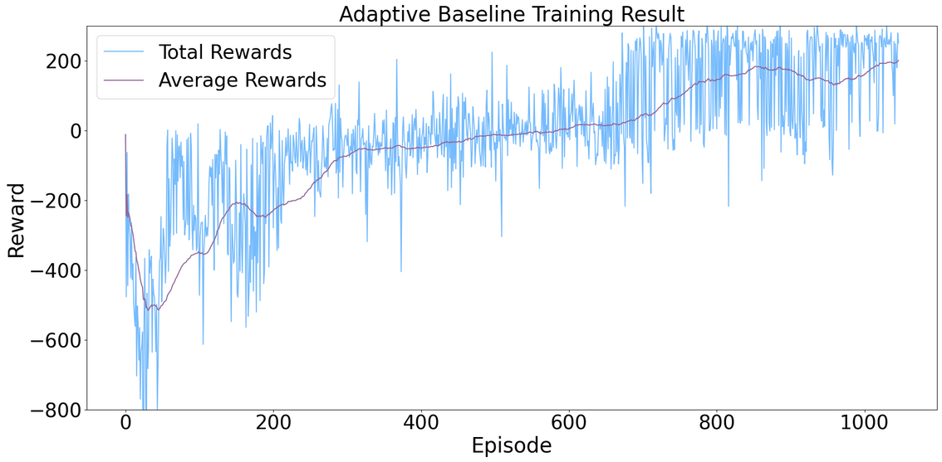
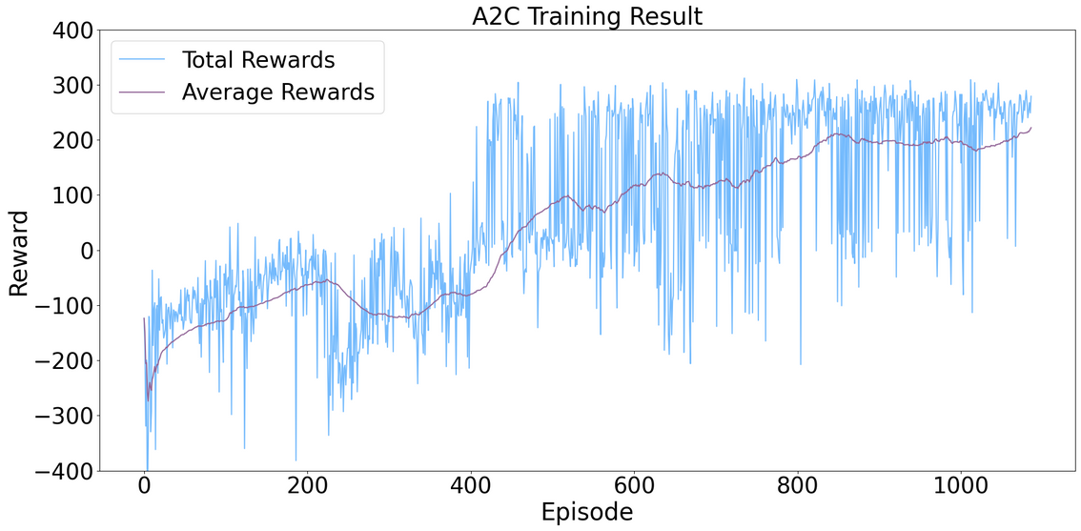
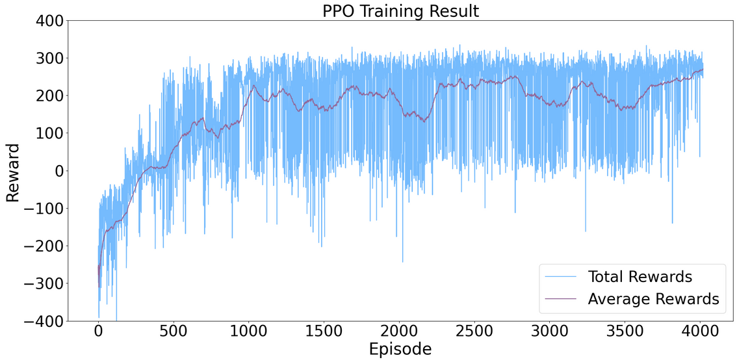
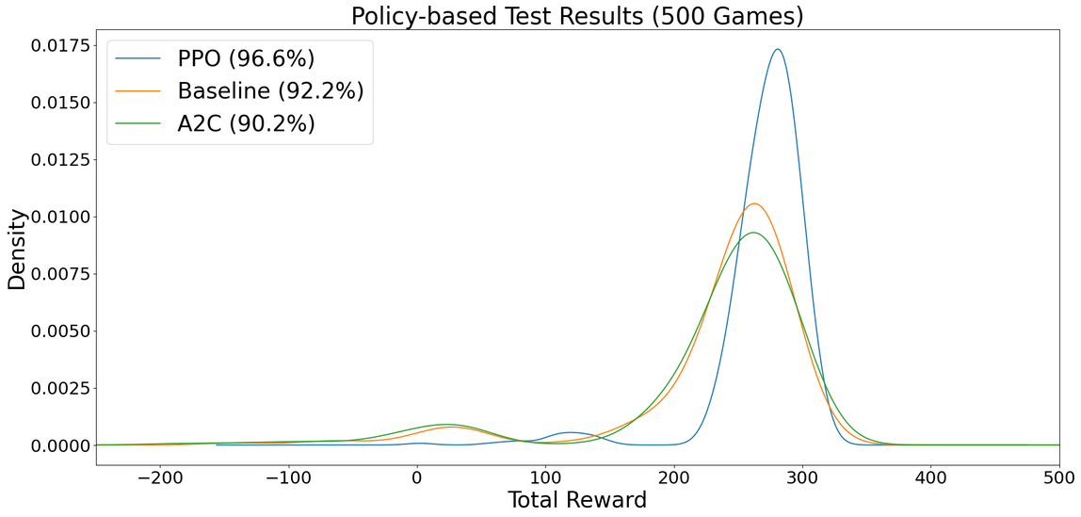
Results (Policy Gradient Pro X)

Slide 3
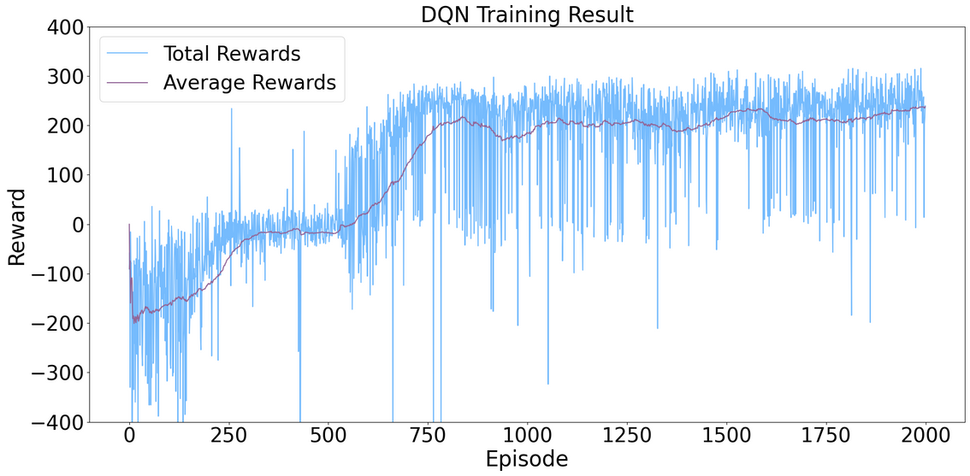
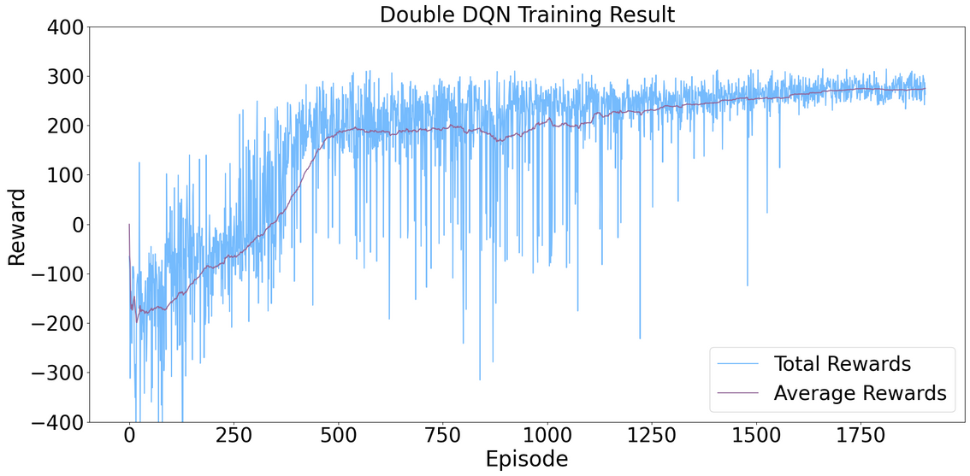
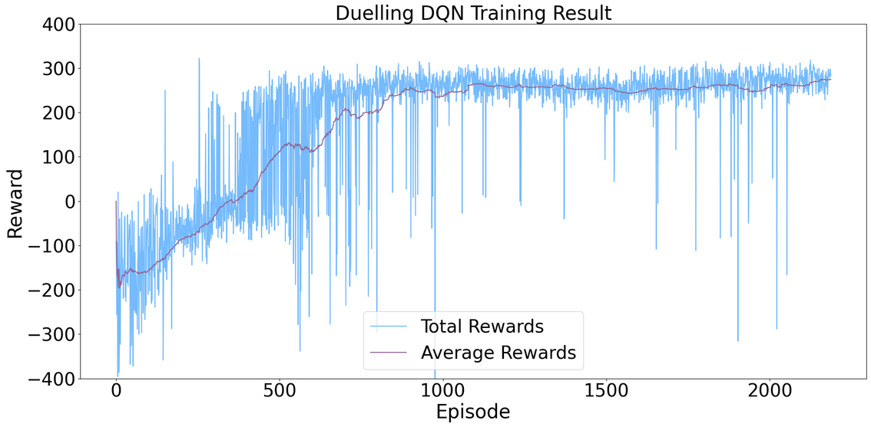
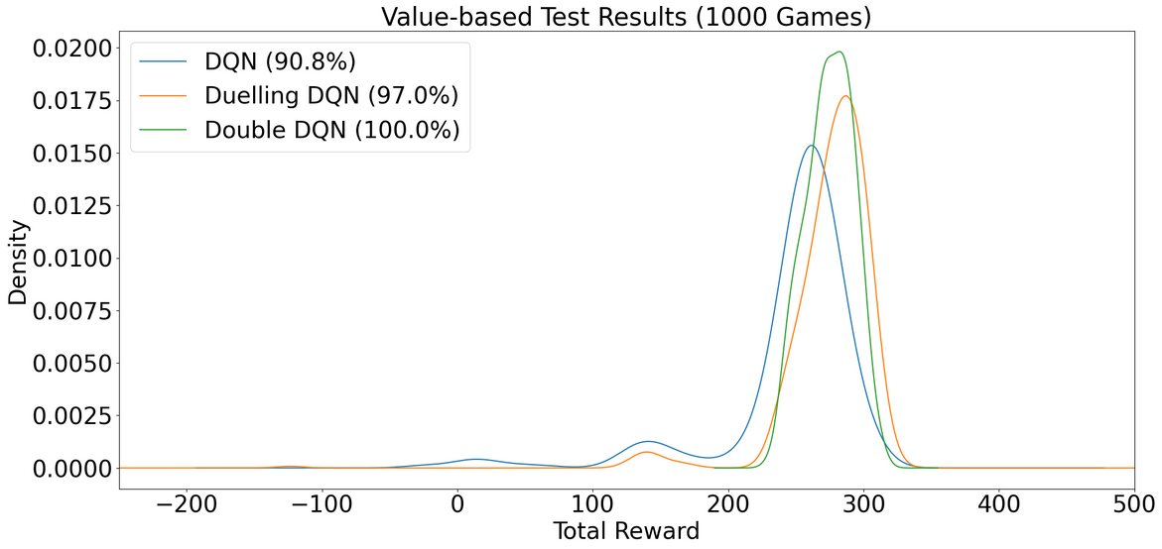
Results (DQN Pro)

Slide 4
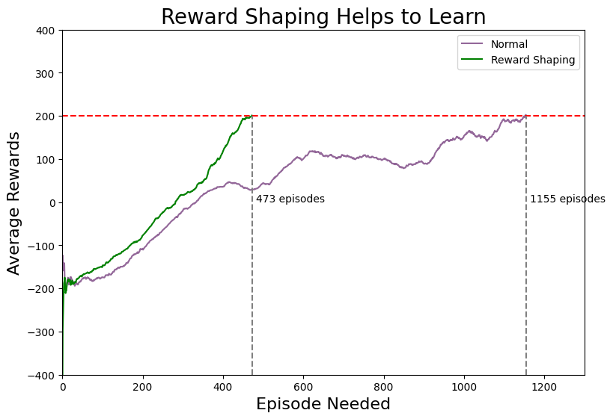
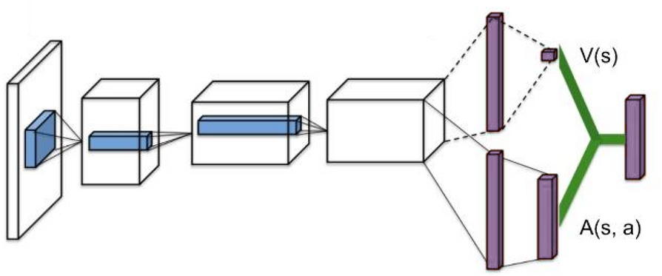
Challenges & Solutions
Convergence & Stability
Speed up convergence and learning stability with Reward Shaping, modify rewards of the environment to encourage the agent to remain close to the center
Policy Gradient Convergence
Issues with convergence due to changing environment with adaptive baseline. Fix the environment to train and test on random environments.
(Top) Training a PPO model with and without reward shaping
(Bottom) Network Architecture of Duelling DQN
Duelling Architectures
Introducing too many hidden layers in the duelling network structure causes a drop in performance

Slide 5
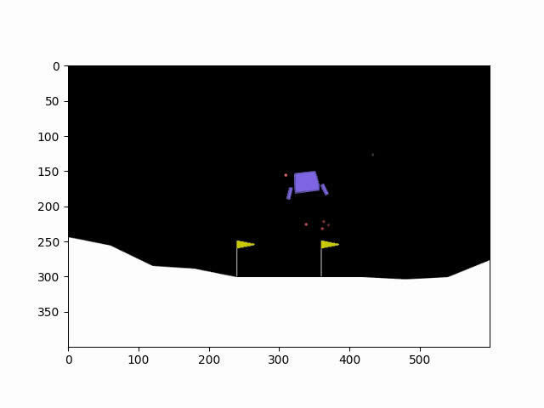
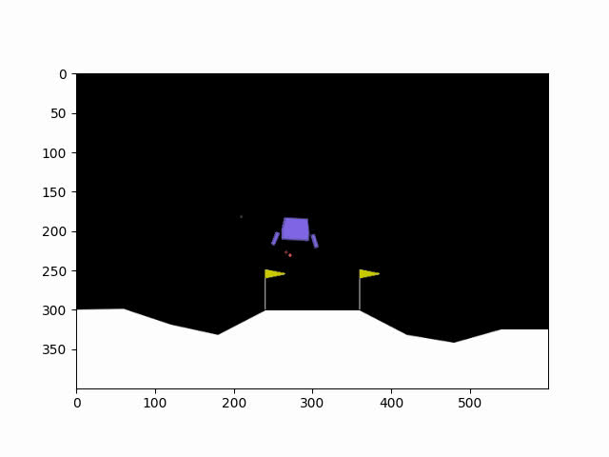
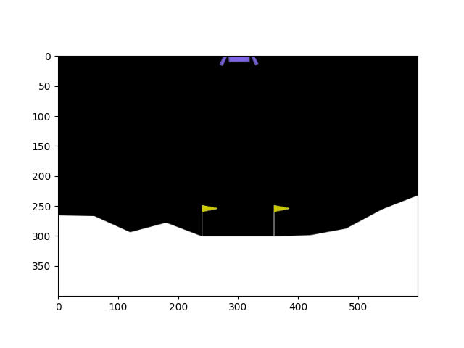
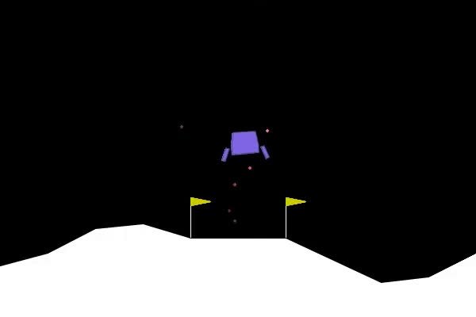
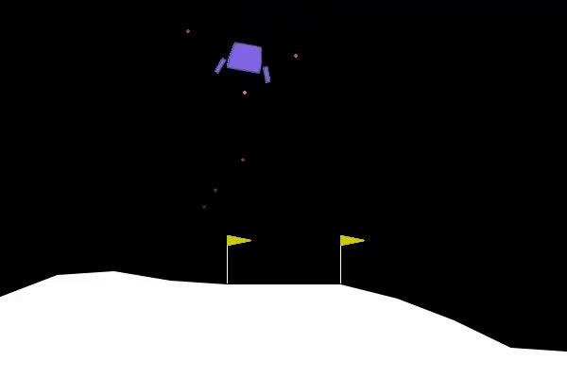
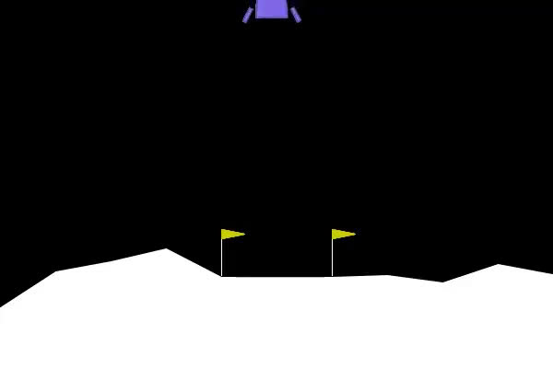
Demo
Baseline
A2C
PPO
DQN
Double DQN
Duelling DQN

